Slide 1

Ethics in Court Operations
Presented By
Judge Audrey Moorehead, M.B.A., J.D.
Texas Center for Legal Ethics, Immediate Past Chair
State Bar of Texas Criminal Justice Section, Chair
Audrey.Moorehead@dallascounty.org

Slide 2
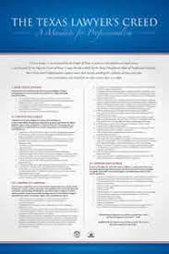
Three Guiding Codes
• NACM Model Code – for court professionals
• Texas Disciplinary Rules – for attorneys
• Judicial Canons – for judges

Slide 3
Shared Ethical Principles
• Impartiality – Equal treatment for all
• Integrity – Honesty and consistency
• Competence – Performing duties effectively
• Accountability – Answering for actions
• Public Trust – Building confidence in courts

Slide 4
Key Differences
• Scope – Staff vs. Attorneys vs. Judges
• Enforcement – Varies by code
• Administrative Oversight – NACM & Canons focus more on staff roles

Slide 5
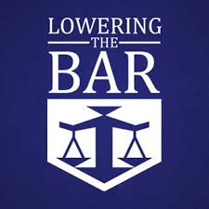
Your Ethical Role
• Represent the court’s professionalism
• Uphold confidentiality and fairness
• Support judicial integrity
• Avoid impropriety and ex parte risks

Slide 6
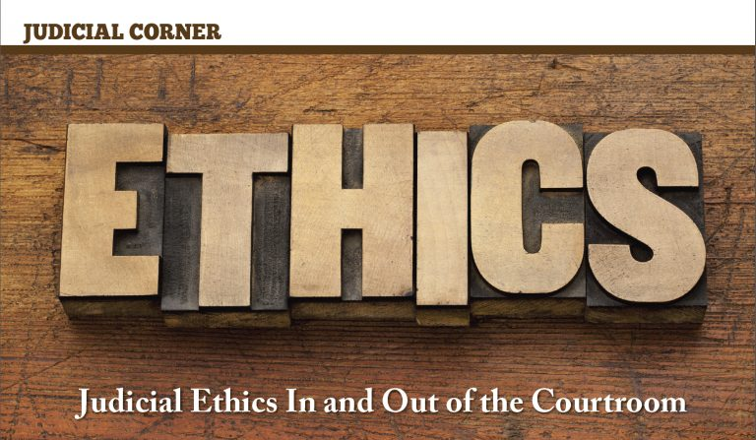
Putting Ethics Into Practice
• Incorporate NACM Code into onboarding
• Model judicial demeanor in public interactions
• Flag ethical concerns appropriately
• Foster a culture of respect and trust

Slide 7
Takeaway
• Ethics is everyone's responsibility
• Understand all three codes
• Lead by example in daily court operations
info@legalethicstexas.com

