Slide 1
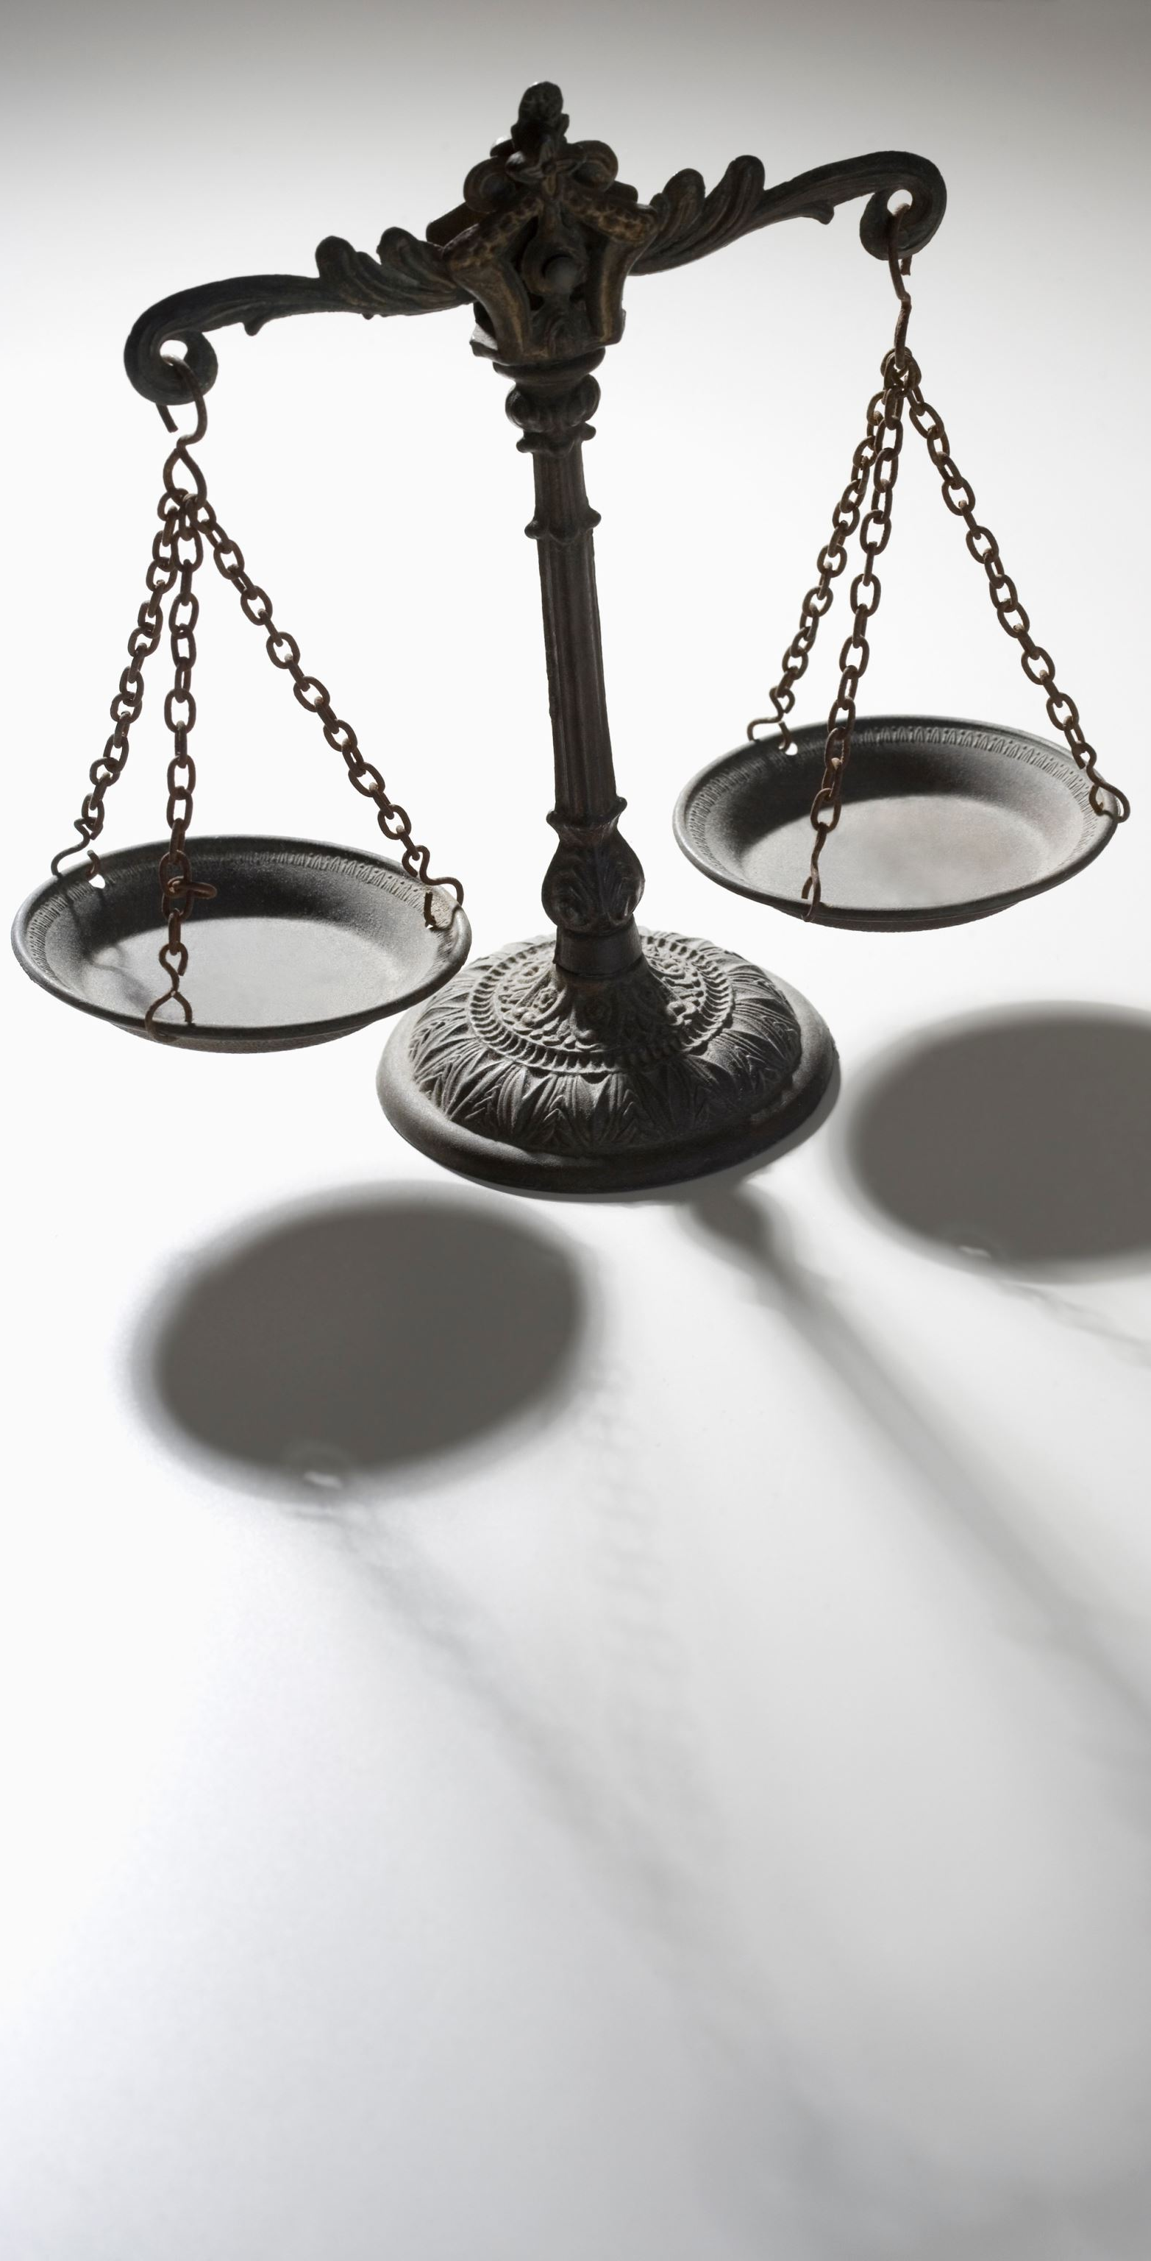
Court Performance Through a Lone Star Lense
Effective Communication and Time Management for Court Personnel

Slide 2



Do not edit How to change the design
Join at slido.com #4719833
The Slido app must be installed on every computer you’re presenting from

Slide 3

Do not edit How to change the design
What word comes to mind when you hear 'effective communication'?
The Slido app must be installed on every computer you’re presenting from

Slide 4
Why Communication Matters in Courts
Justice depends on clarity, respect, and precision
Public perception shaped by court interactions

Slide 5
Who We Communicate With
Internal: Judges, clerks, bailiffs, interpreters
External: Attorneys, witnesses, jurors, general public

Slide 6
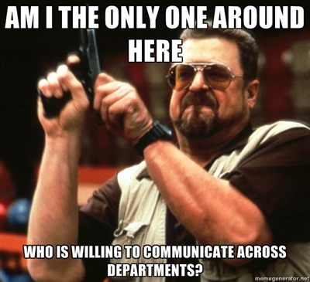

Slide 7
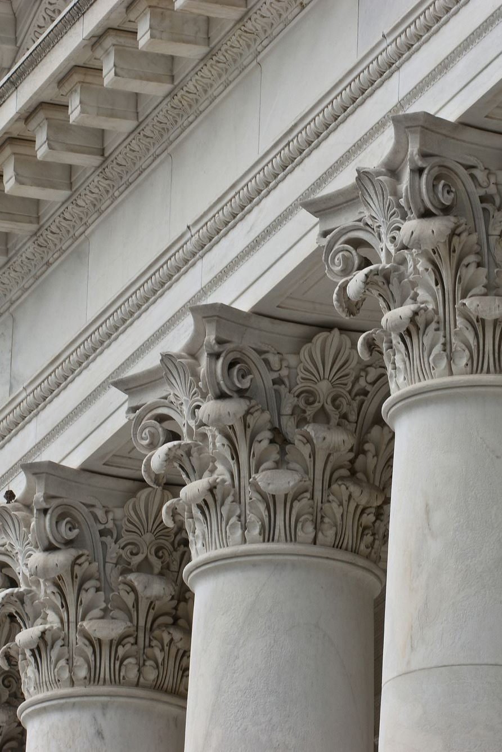
Pillars of Effective Communication
Clarity
Active Listening
Professionalism
Confidentiality
Cultural Competence

Slide 8

Do not edit How to change the design
What do you find most challenging in court communications?
The Slido app must be installed on every computer you’re presenting from

Slide 9
Clarity in Action
Use plain language, avoid legal jargon
Double-check written instructions and notices

Slide 10
Methods of Communication
Verbal
Written
Visual
Non-Verbal

Slide 11
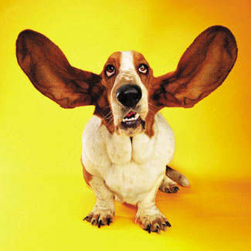
Most Important Communication Skill
Listening
Practice active listening
Watch your non-verbal communication when listening
Eliminate distractions

Slide 12
The Power of Listening
Listen to understand, not just respond
Use paraphrasing and nonverbal cues

Slide 13
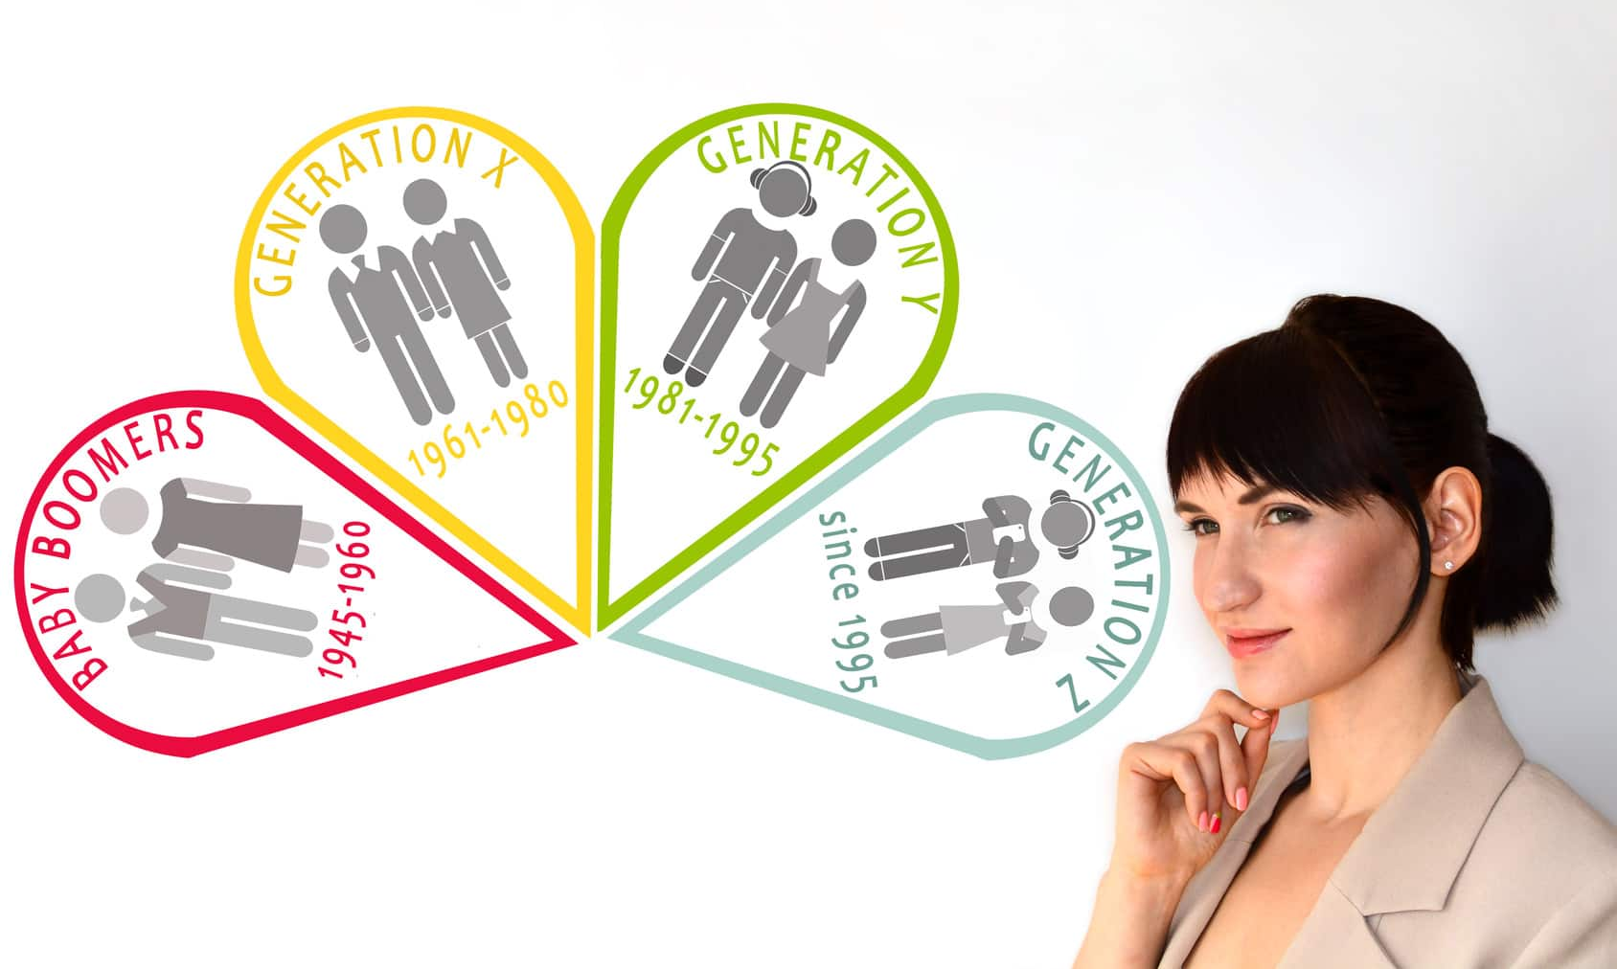
Communicating with different generations

Slide 14
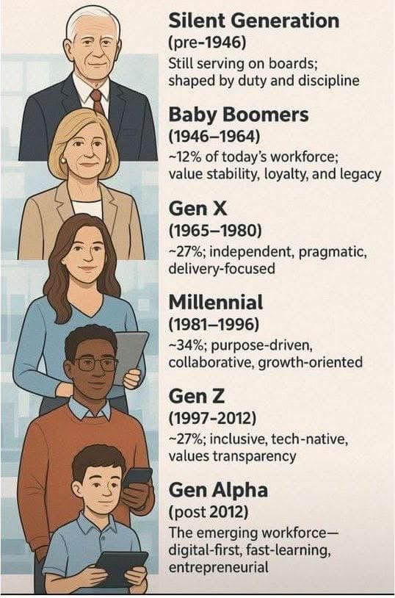

Slide 15
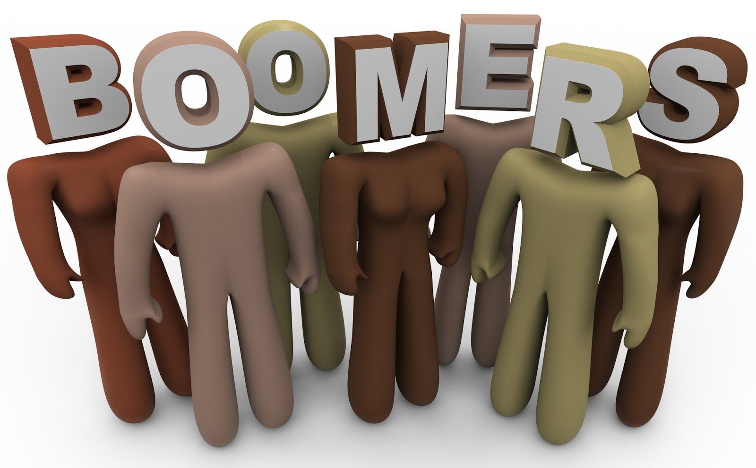
Baby Boomers
(1946-1964)-Prefer a balance between email, telephone, face to face and meetings. “Call me any time”

Slide 16

Generation X (1965-1976)
Not enamored with long meetings, prefer email communication. Be direct. Very individualistic. “Call me at work”

Slide 17

Millennials 1977-1996
They like teamwork. Text or email them. Phone calls are seen as invasive. They rely on social media for information.

Slide 18
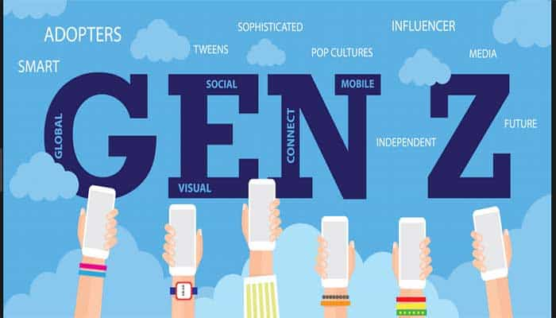
Generation Z 1996-2009
This Photo by Unknown Author is licensed under CC BY-NC-ND
Never lived in a world without cell phones and computers. Very internet savvy.

Slide 19
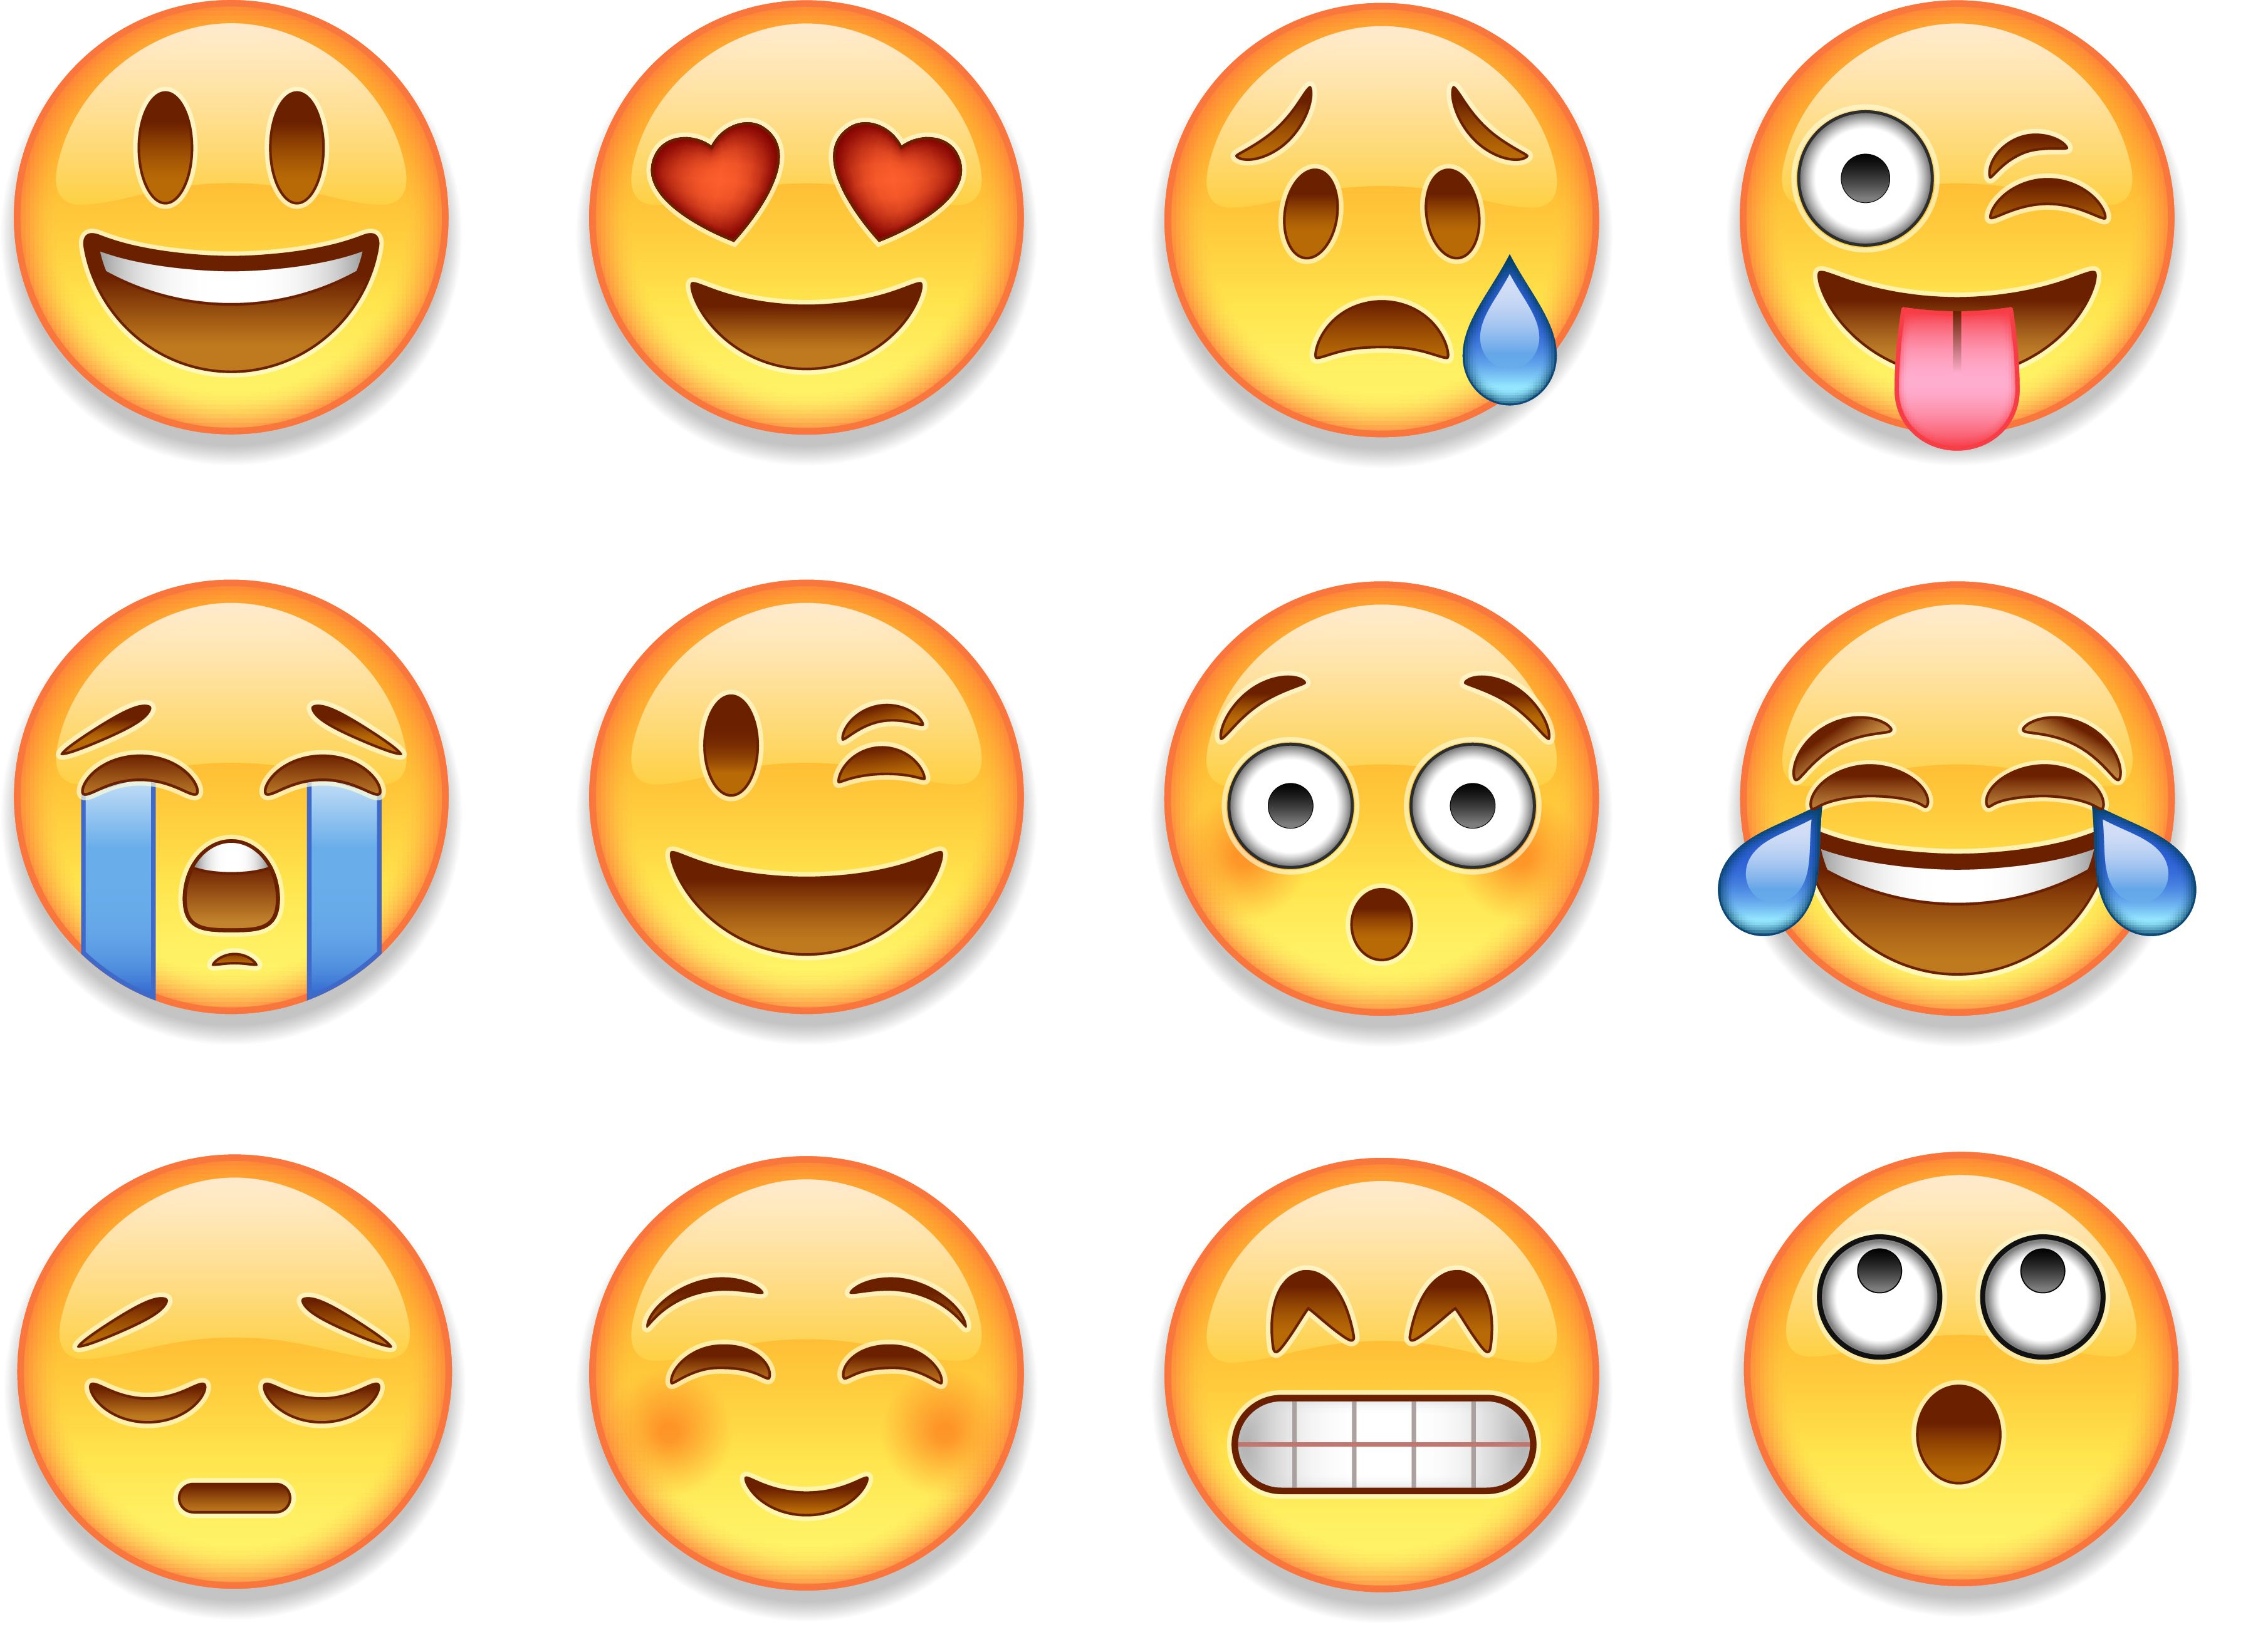
Generation Alpha 2010-2024
Primarily communicates through digital channels, often preferring visual and interactive content. They are digital natives, comfortable with technology and social media, and often engage with short-form video, emojis, and GIFs. Authenticity and interactivity are key to capturing their attention.

Slide 20
Do not edit How to change the design
Which generation do you think is hardest to communicate with in court settings?
The Slido app must be installed on every computer you’re presenting from

Slide 21
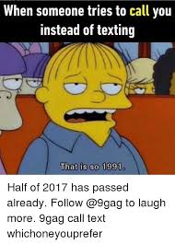

Slide 22
Tips for effective communication across the generations
Get everyone on the same page
Use multiple communication avenues
Personalize your approach
Understand the differences
Be aware that different generations are motivated differently
Ask, don’t assume
Be willing to teach and be taught

Slide 23

Do not edit How to change the design
How confident are you in your communication skills when dealing with different generations?
The Slido app must be installed on every computer you’re presenting from

Slide 24
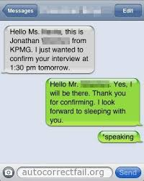
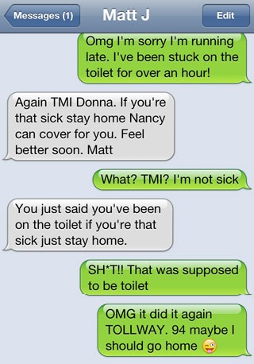
Use the right form of communication for the task

Slide 25
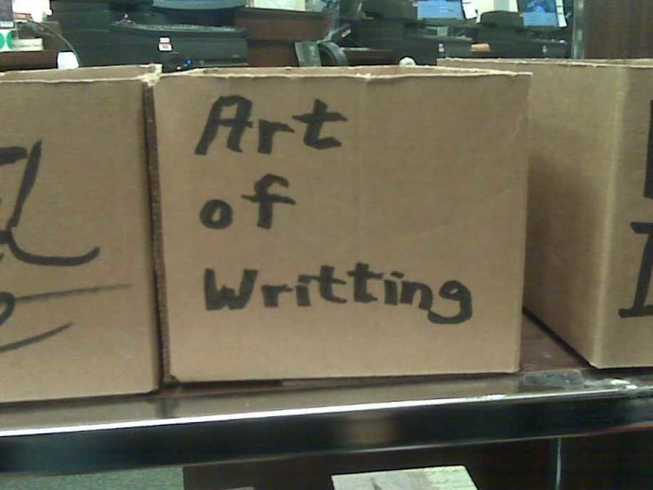
E-Mail
Include a clear succinct subject line
Think twice before hitting “reply all”
Include a signature block
Be cautious with humor
Proofread your messages
Add the email address last to
prevent premature sending!
Double check the address!

Slide 26
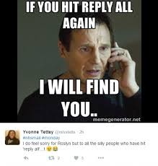

Slide 27
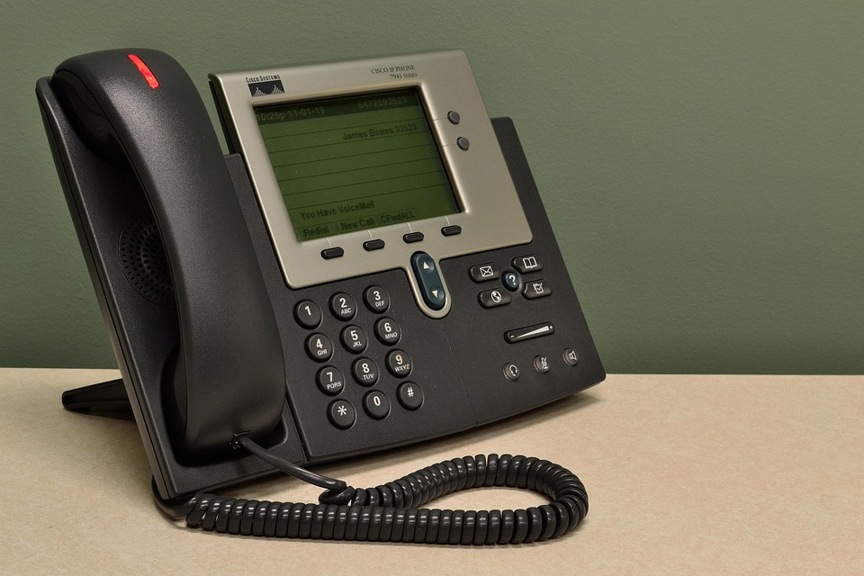
Telephone
State your name at the beginning of the call
Do not eat or drink while on the phone
Listen!
Always let someone know if they are on speakerphone
Close with courtesy

Slide 28

Letters
One page, if possible.
Keep the tone formal and factual.
Make it clear, concise and logical.
Put technical details in an attachment
Watch your language-gender, race, etc…
Proofread!

Slide 29

Using AI
Remember, people want to hear from a HUMAN!
Always, always proof read after generating
Understand that “garbage in”=“garbage out”
"I hope this email finds you well"

Slide 30

Professional Ethics
Honesty
Trustworthiness
Loyalty
Respect for others
Adherence to the law
Doing good and avoiding harm to others
Accountability

Slide 31
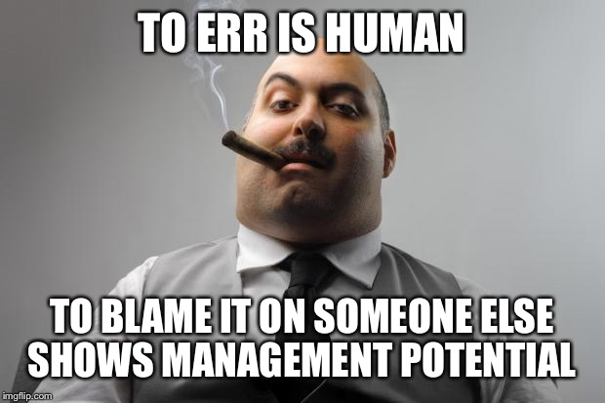

Slide 32
Maintaining Professionalism
Neutral tone under pressure
Respectful, unbiased demeanor

Slide 33
Do not edit How to change the design
In what situation is it hardest to maintain your professionalism?
The Slido app must be installed on every computer you’re presenting from

Slide 34
Confidentiality and Boundaries
Know what is public vs. confidential
Avoid casual conversations about cases

Slide 35
Communicating Across Cultures and Barriers
Cultural sensitivity is essential
Use interpreters and provide accommodations

Slide 36
Common Challenges
Dealing with emotion, aggression, and urgency
Avoid digital miscommunication

Slide 37
Do not edit How to change the design
What is your biggest challenge when communicating in your work place?
The Slido app must be installed on every computer you’re presenting from

Slide 38
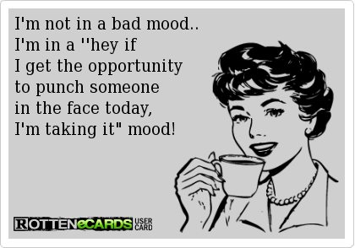
How Do you treat others?

Slide 39
Respect others
Treat everyone with courtesy, politeness and kindness
Encourage co-workers to express their opinions and ideas
Listen to what others have to say. Don’t interrupt. Focus on what they say instead of your response
Let others see their ideas put into action

Slide 40
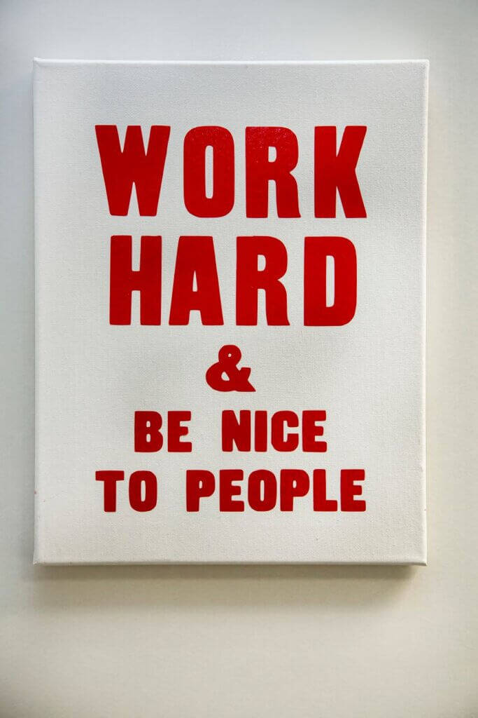
Never insult people, use name calling, disparage or put down people or their ideas
Don’t constantly criticize over little things
Be aware of your body language, tone of voice and your demeanor.

Slide 41

Treat everyone fairly and equally.
Don’t leave anyone out
Praise more than you criticize

Slide 42

Do not edit How to change the design
What methods work best when working with others to solve a problem?
The Slido app must be installed on every computer you’re presenting from

Slide 43

Time Management

Slide 44
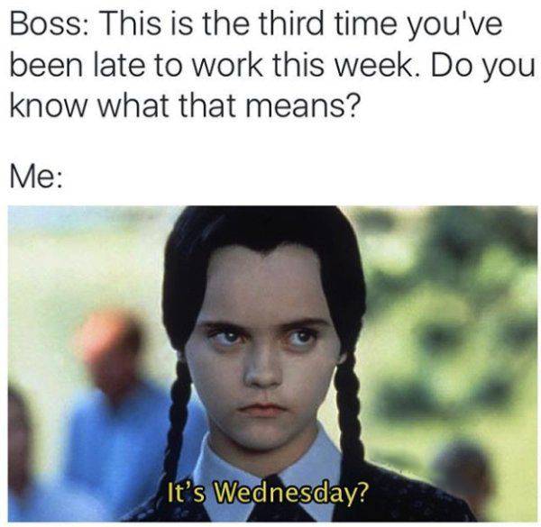

Slide 45
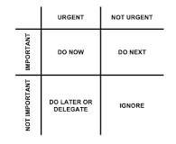
Prioritize

Slide 46
Schedule Tasks
Focus on the essentials
Divide it into work, home and personal
Find an app you like!
Todoist
Wunderlist
Anylist

Slide 47
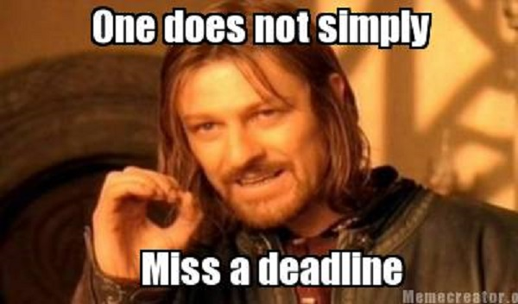
Set Deadlines

Slide 48

Overcome Procrastination
Perfectionist-forever seeking the perfect timing or approach
Ostrich-stays in the dreaming stage
Self-Saboteur-if you do nothing-no mistakes!
Daredevils-waiting until the deadline to begin
Chicken-don’t prioritize

Slide 49
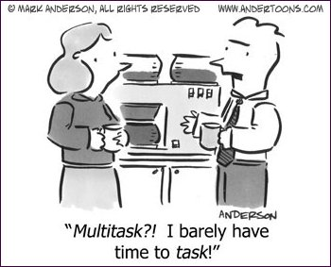
Avoid Multitasking

Slide 50
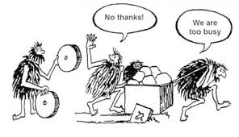
Learn to say “no”

Slide 51
Do not edit How to change the design
Which time management technique do you struggle with the most?
The Slido app must be installed on every computer you’re presenting from

Slide 52
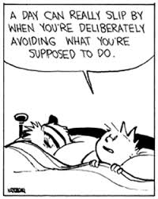

Slide 53
Dealing with Stress Wisely
Don’t stress about yesterday
Take a break
Remember to delegate and ask for help
Try to stay positive

Slide 54
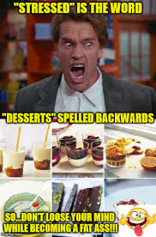

Slide 55
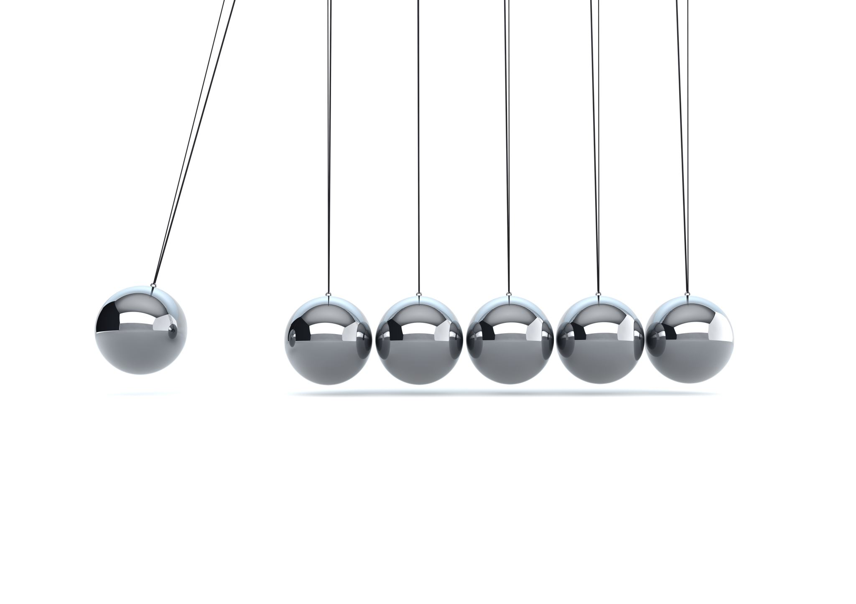
Platinum Rule
Treat others as they wish to be treated

Slide 56

This Photo by Unknown Author is licensed under CC BY-SA-NC

